Slide 1

AQI Prediction Using Machine Learning
Team - 1
Arpita Madhukar Kalburgi | 801369964
Sai Harsha Vunnava | 801418991
Prabath Sandhi | 801420329
Forecasting Air Quality Index (AQI) in the USA Using Machine Learning
Notes:
“Hello, everyone. My name is Arpita -From Team 1, and Today, I'll walk you through our final project where we forecast the Air Quality Index, or AQI, using machine learning.
Our goal was to use real-world data to predict pollution levels in advance, helping people and cities make smarter decisions for their health and planning.

Slide 2

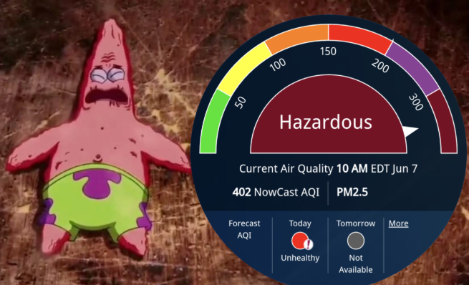
What is AQI?
AQI is a standardized index for pollution severity (0–500 scale)
High AQI = Risk to health, especially for sensitive groups
Forecasting AQI helps people and policymakers plan ahead
Why does it matter? - Health Warnings - Government Response - Planning Activities - Weather Interplay
Notes:
So, the Air Quality Index—or AQI—is basically a simple way to tell how clean or polluted the air is. Instead of throwing a bunch of complex pollution data at you, it gives you one number between 0 and 500. Lower numbers mean the air’s good, and the higher it goes, the more hazardous it gets. We’ve all seen AQI warnings pop up in weather apps. But what if we could predict that number days or months in advance? That’s the challenge I took on. The idea was to build a model that helps not just cities, but everyday people decide: is it safe to run outdoors today? Should we issue an alert for seniors? These are the kinds of decisions AQI forecasting can support.
Why it matters? When AQI is high, it can really mess with people’s breathing—especially kids, older folks, or anyone with asthma or heart issues.
Governments also watch AQI closely. If it spikes, they might issue smog alerts, limit traffic, or even shut down some industrial activity to keep things from getting worse.
Weather plays a big role too. So, AQI isn’t just about pollution—it’s also about how the weather moves it around.

Slide 3
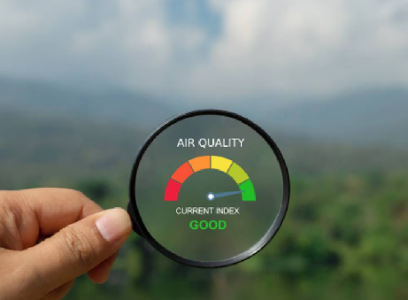
Introduction & Problem Statement
Air Quality Index (AQI) plays a vital role across multiple sectors: Public Health: AQI alerts help individuals, especially those with respiratory illnesses, avoid harmful exposure.
Urban Planning: City infrastructure decisions like traffic regulation or zoning benefit from AQI trends.
Environmental Research: AQI data supports studies on pollution sources and ecosystem impacts.
Education & Awareness: Forecasts educate the public and encourage behavioral shifts on high-risk days.
Weather Forecasting: AQI is influenced by humidity, wind patterns, and temperature inversions, making weather data a crucial complementary input for modeling.
Notes:
Air pollution’s a big deal—it impacts everything from our health to how cities run. That’s why being able to predict AQI (Air Quality Index) ahead of time is so important. It lets people know when it’s safe to be outside. And it’s not just about individuals. Cities can actually use this info for smarter planningPlus, AQI and weather are totally linked. So, this project’s all about using machine learning and real data—like pollution levels and population stats—to predict AQI trends. The goal? Give both people and cities a heads-up so they can make healthier choices before the air gets bad.

Slide 4
Data Sources
['Unnamed: 0', 'CBSA Code', 'Date', 'AQI', 'Category', 'Defining Parameter', 'Number of Sites Reporting', 'city_ascii', 'state_id', 'state_name', 'lat', 'lng', 'population', 'density', 'timezone']
Raw Daily AQI Readings
↓
Monthly Aggregated AQI per City ['city_ascii', 'state_name', 'Year', 'Month', 'Monthly_Avg_AQI']
↓
Merged with State-Level Pollution & Population Summaries
↓
Feature Engineering (Pollution % Seasonality, Demographics)
↓
Final Cleaned Dataset for Machine Learning
• Aggregated noisy daily data into monthly city-level trends
• Enriched with state-wide pollutant exposure and population
• Engineered critical features (% Unhealthy Days, PM2.5 impact, Seasonal variation)
• Created a stable, interpretable dataset for predictive modeling
['Geo_Loc', 'Year', 'State', 'Pop_Est', 'TTL_Cnty', 'Cnty_Rpt', 'Dys_w_AQI', 'Dys_NM', 'Dys_Blw_Thr', 'Dys_Abv_Thr', 'Good Days', 'Moderate Days', 'Unhealthy for Sensitive Groups Days', 'Unhealthy Days', 'Very Unhealthy Days', 'Hazardous Days', 'Max AQI', '90th Percentile AQI', 'Median AQI', 'Days CO', 'Days NO2', 'Days Ozone', 'Days PM2.5', 'Days PM10']
[ city_ascii, State, Year, Month, Monthly_Avg_AQI, Pop_Est, Dys_w_AQI, Dys_NM, Dys_Blw_Thr, Dys_Abv_Thr, Days PM10, pct_unhealthy, pct_good, pct_moderate, pct_pm25_days, pct_ozone_days, total_pollutant_days, Season_Spring, Season_Summer, Season_Winter ]
Notes:
To support accurate AQI prediction, I relied on a series of datasets that captured both fine-grained air quality readings and broad environmental context.
Raw AQI Dataset (capital_cities_aqi.csv) – Daily AQI readings for U.S. capital cities. This dataset served as the foundation for capturing real-time pollution trends across regions. It was later processed to derive monthly trends.
Monthly Aggregated AQI (monthly_avg_aqi.csv) – Created by grouping the raw AQI data by city and month. This dataset provided smoothed temporal information and served as the base for merging.
State-Level Pollution Summaries (state_level_aqi.csv) – Annual pollution and population estimates at the state level. These values included pollutant-specific day counts and demographic context.
Merged Dataset (merged_aqi_dataset.csv) – Produced by merging monthly AQI data with state-level summaries using State and Year. This integration enabled each AQI reading to be informed by both time and regional conditions.
Final Modeling Dataset (aqi_model_ready.csv) – Result of cleaning and feature engineering on the merged dataset. This version was used to train and test machine learning models.
We started with daily AQI readings for U.S. capital cities, then aggregated them into monthly averages to reduce noise.
We also added state-level pollution summaries and population data to give a broader context.
Merging these datasets allowed us to capture both local trends and regional pollution factors — making the data richer and more useful for modeling..

Slide 5
Assumptions made:
Assume that state-level pollutant days apply uniformly to all cities within the state when merging datasets.
Assume no missing months unless explicitly identified.
Notes:
While merging data, we made some practical assumptions.
We assumed that state-level pollution data could apply uniformly to cities within that state.
Also, unless missing months were clearly identified, we treated the dataset as complete.

Slide 6
Data Processing
Started with raw daily AQI readings from cities.
Aggregated into monthly averages to reduce noise and spot trends.
Dropped missing AQI readings before aggregation.
Handled outliers via capping monthly averages above 500 AQI.
Merged with state-level pollution & population data using State and Year.
Result: richer dataset showing both city-specific and state-wide trends.
Dataset now includes ~3,450 rows and 35+ useful columns.
Observed patterns in AQI based on seasonality and population size.
Notes:
To make the data ready for modeling, we first cleaned it by removing missing AQI readings.
We aggregated daily data into monthly averages, handled outliers by capping AQI at 500, and merged in broader pollution and population metrics.
This gave us a stable dataset with around 3,450 records and over 35 useful features — capturing trends across seasons and population sizes.

Slide 7
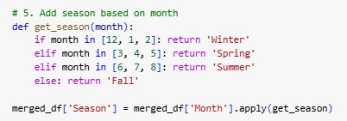
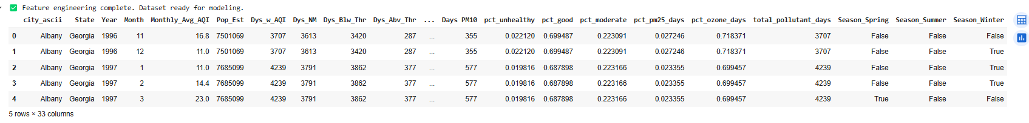
Feature Engineering
Created features: % Unhealthy Days, % PM2.5 Days
Summed total pollutant days
Encoded seasons into Winter, Spring, Summer, Fall (one-hot)
Notes:
After cleaning the data, we created new features to improve model accuracy.
Calculated % Unhealthy Days, % PM2.5 Days, and Total Pollutant Days — all strongly related to AQI.
Added season information based on the month and used one-hot encoding for model readability.
These engineered features helped the model learn pollution patterns more effectively than using raw data alone.

Slide 8
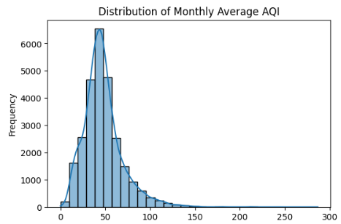
Exploratory Data Analysis
Histogram shows AQI is right-skewed
Most cities have low AQI; few have extremely high pollution.
Notes:
Before modeling, we conducted exploratory data analysis to better understand the relationships in the dataset. We found that AQI values were right-skewed, meaning most cities typically had clean air, but a few had very high pollution levels.

Slide 9
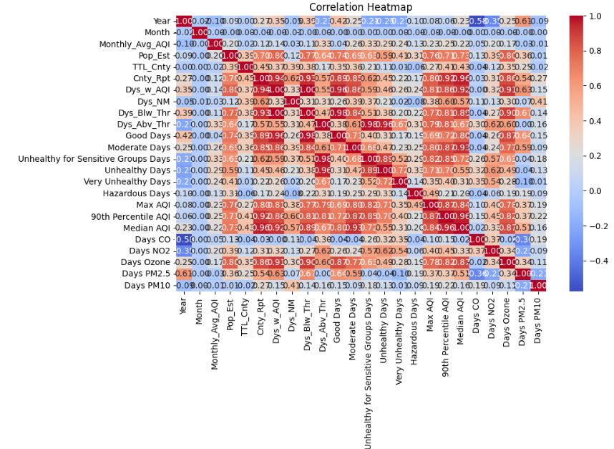
Correlation heatmap highlights top features
Population and % Unhealthy Days have strong positive correlations with AQI.
Notes:
The correlation heatmap showed strong positive relationships between AQI and features like population size, percentage of unhealthy days, and PM2.5-related days.

Slide 10
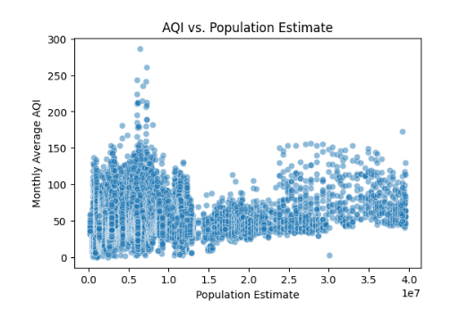
Population vs AQI reveals positive trend
Larger populations generally correlate with higher AQI values.
Notes:
When plotting Population vs. AQI, we observed a clear upward trend — more populous cities tend to have higher AQI values. These insights confirmed that both environmental factors and human activity strongly affect air quality.
This understanding guided our feature selection and helped us pick models that can handle non-linear relationships

Slide 11
Model Selection & Setup
Compared: Decision Tree, Random Forest, Linear Regression
Random Forest and Decision Tree performed similarly (R² ≈ 0.41)
Random Forest selected for better generalization and stability
80/20 train-test split used
Notes:
After preparing the data, we evaluated three machine learning models:
Decision Tree Regressor
Random Forest Regressor
Linear Regression
We performed an 80-20 train-test split to fairly assess the models. Both the Decision Tree and Random Forest models performed similarly with an R² score of around 0.41. However, we chose Random Forest because it tends to generalize better, avoid overfitting, and provide more stable predictions, especially with noisy real-world data like environmental readings."

Slide 12
Model Evaluation
Random Forest achieved R² ≈ 0.41
RMSE for Random Forest: ~17.02
MAE for Random Forest: ~12.35
Random Forest offers balance of accuracy and interpretability
Notes:
Evaluating the Random Forest model, we achieved the following metrics:
R² Score: 0.41 — meaning the model explained 41% of the variance in AQI values.
Root Mean Squared Error (RMSE): about 17.02
Mean Absolute Error (MAE): about 12.35
Considering that air pollution levels are influenced by many unpredictable external factors like wildfires.

Slide 13
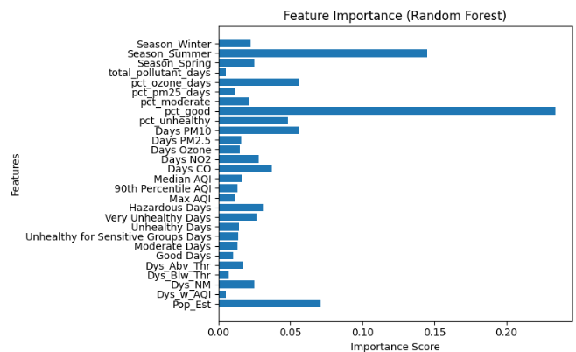
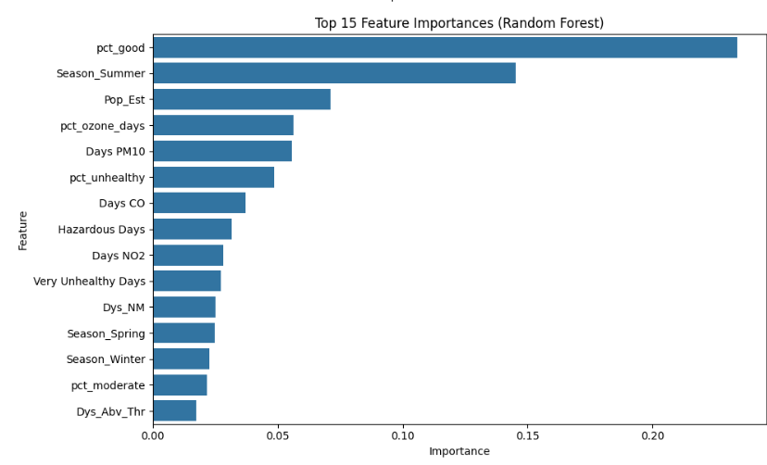
Feature Importance
Random Forest chosen after model comparison
Top predictors: % Unhealthy Days, PM2.5 Days, Population
Feature importance helped validate domain knowledge
Notes:
Using the Random Forest model, we also analyzed feature importance to understand what factors drive AQI the most. The top predictors were:
Percentage of Unhealthy Days — the more unhealthy days, the higher the predicted AQI.
PM2.5 Days Percentage — PM2.5 is known to be one of the most dangerous pollutants.
Population Size — higher population density often leads to higher pollution.
Interestingly, seasonal indicators like Winter and Summer also played moderate roles. These findings aligned well with our domain knowledge and early EDA, giving us more confidence in the model’s validity."

Slide 14
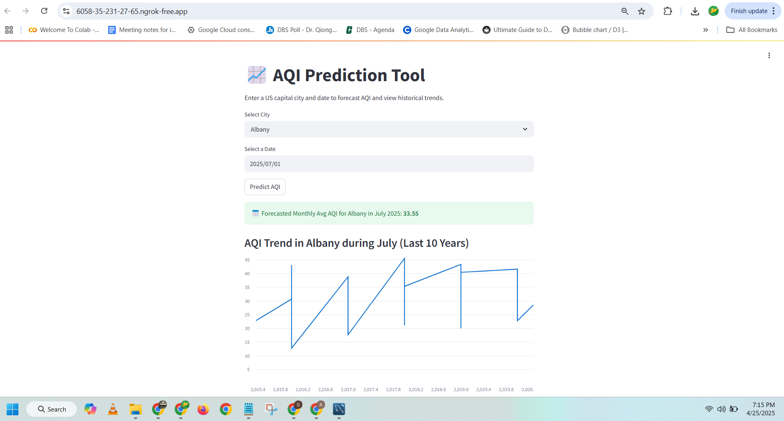
Visualization
Deployed AQI predictor Streamlit app
Input: City + Date → Automatically derive features → Predict AQI
Notes:
Our final model workflow is simple and user-friendly.
The user only needs to provide two inputs — the City and the Date they are interested in.
Behind the scenes, the system automatically derives all the necessary features —
like the season based on the month, the state-level pollution trends, the population estimate, and pollution-specific day percentages like PM2.5 days and unhealthy days.
Using these derived features, the trained Random Forest model then predicts the expected AQI for that city and month.
This automatic feature generation ensures that users don't have to worry about technical details — the model takes care of it and delivers an accurate AQI forecast quickly and efficiently.

Slide 15
Conclusion
Built full ML pipeline
Random Forest offered best trade-off
Model extracts meaningful AQI patterns
Notes:
This project took raw AQI data, combined it with demographic and pollutant trends, and produced meaningful insights and predictions through a deployed app.

